Slide 1
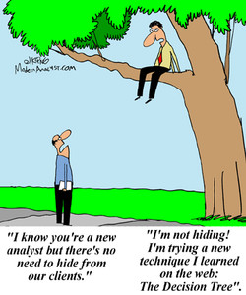
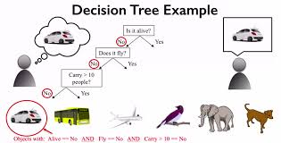
Decision Trees
Dr. D. Sumathi

Slide 2

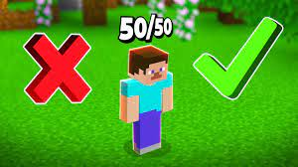
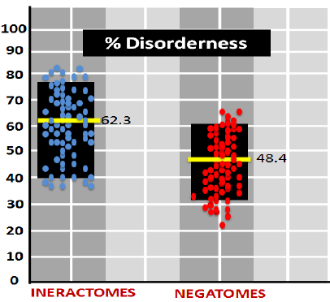
Decision Tree Learning
Decision tree learning is a method for approximating discrete-valued target functions.
The learned function is represented by a decision tree.
– A learned decision tree can also be re-represented as a set of if-then rules.
Decision tree learning is one of the most widely used and practical methods for inductive inference.
It is robust to noisy data and capable of learning disjunctive expressions.
Decision tree learning method searches a completely expressive hypothesis – Avoids the difficulties of restricted hypothesis spaces.
– Its inductive bias is a preference for small trees over large trees
• The decision tree algorithms such as ID3, C4.5 are very popular inductive inference algorithms, and they are successfully applied to many leaning tasks.

Slide 3
Decision Tree
A Decision Tree is a supervised Machine learning algorithm. It is used in both classification and regression algorithms. The decision tree is like a tree with nodes.
As the name goes, it uses a tree-like model of decisions. They can be used either to drive informal discussion or to map out an algorithm that predicts the best choice mathematically.
A decision tree typically starts with a single node, which branches into possible outcomes. Each of those outcomes leads to additional nodes, which branch off into other possibilities. This gives it a tree-like shape.

Slide 4
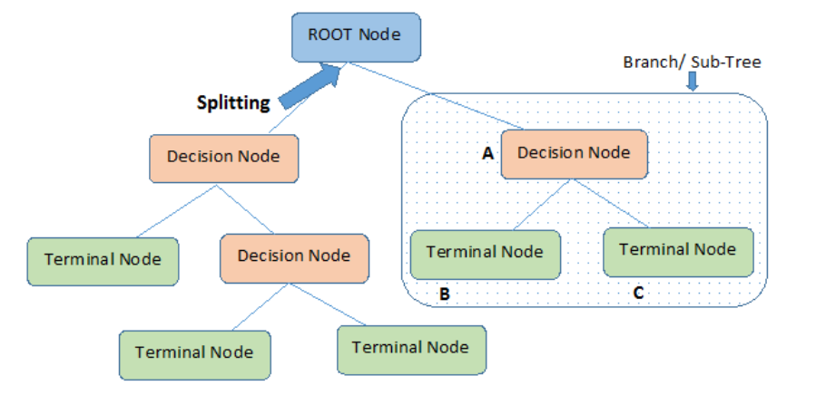
The branches depend on a number of factors. It splits data into branches like these till it achieves a threshold value. A decision tree consists of the root nodes, children nodes, and leaf nodes.

Slide 5
Decision Tree for PlayTennis
Outlook
Sunny
Overcast
Rain
Humidity
Each internal node tests an attribute
High
Normal
Each branch corresponds to an
attribute value node
No
Yes
Each leaf node assigns a classification

Slide 6
Decision Tree for Conjunction
Outlook=Sunny ∧ Wind=Weak
Outlook
Sunny
Overcast
Rain
Wind
No
No
Strong
Weak
No
Yes

Slide 7
Decision Tree for Disjunction
Outlook=Sunny ∨ Wind=Weak
Outlook
Sunny
Overcast
Rain
Yes
Wind
Wind
Strong
Weak
Strong
Weak
No
Yes
No
Yes

Slide 8
Decision Tree for XOR
Outlook=Sunny XOR Wind=Weak
Outlook
Sunny
Overcast
Rain
Wind
Wind
Wind
Strong
Weak
Strong
Weak
Strong
Weak
Yes
No
No
Yes
No
Yes

Slide 9
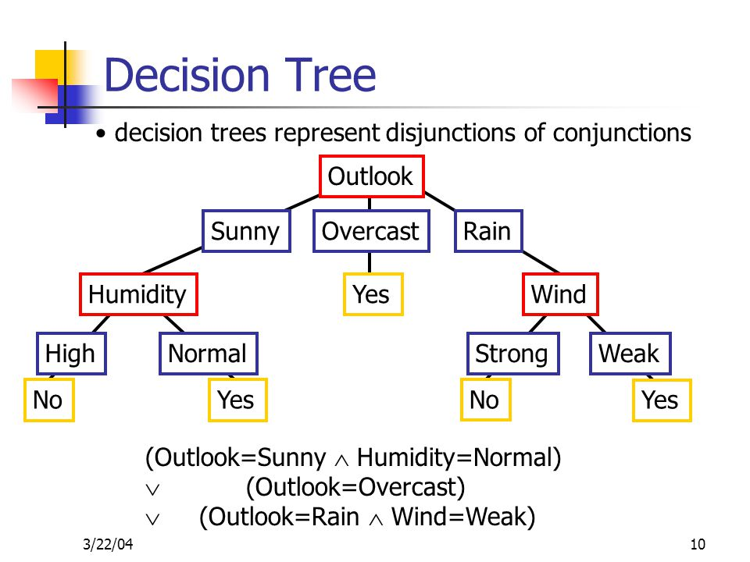
Decision trees represent a disjunction of conjunctions of constraints on the attribute values of instances.
Each path from the tree root to a leaf corresponds to a conjunction of attribute tests, and
The tree itself is a disjunction of these conjunctions

Slide 10
Algorithm
1. Select the best Feature using Attribute Selection Measures(ASM) to split the records.
2. Make that attribute/feature a decision node and break the dataset into smaller subsets.
3 Start the tree-building process by repeating this process recursively for each child until one of the following condition is being achieved :
a) All tuples belonging to the same attribute value.
b) There are no more of the attributes remaining.
c ) There are no more instances remaining.

Slide 11
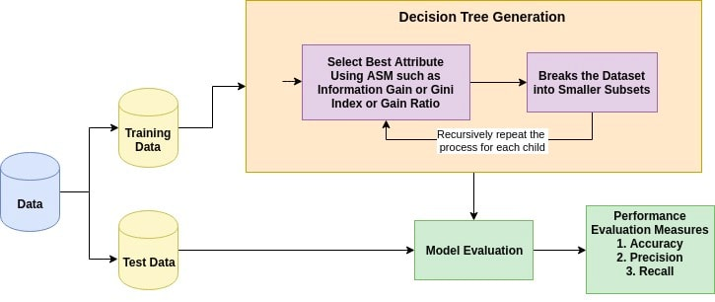

Slide 12
With the help of ASM, we can easily select the best features for the respective nodes of the decision tree.
There are two techniques for ASM:
a) Information Gain
b) Gini Index
c) Gain Ratio
Information Gain:
Information gain is the measurement of changes in entropy value after the splitting/segmentation of the dataset based on an attribute.
It tells how much information a feature/attribute provides us.
Following the value of the information gain, splitting of the node and decision tree building is being done.
decision tree always tries to maximize the value of the information gain, and a node/attribute having the highest value of the information gain is being split first.

Slide 13


Who sleeps after lunch?????

Slide 14
VARIOUUS DECISION TREE ALGORITHMS
ID3 → (extension of D3) C4.5 → (successor of ID3) CART → (Classification And Regression Tree) CHAID → (Chi-square automatic interaction detection Performs multi-level splits when computing classification trees) MARS → (multivariate adaptive regression splines)

Slide 15
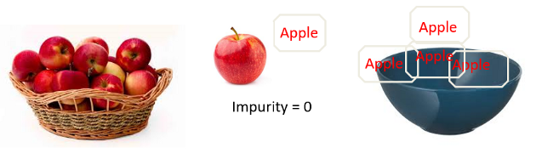
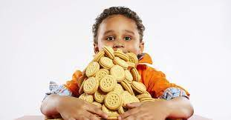
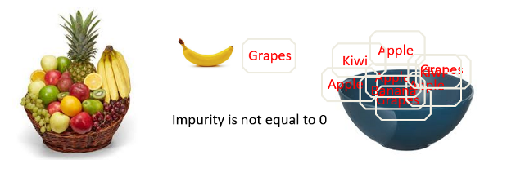
GUESS THE PRINCIPLE
Iterative Dichotomiser 3 –ID3

Slide 16
Top-Down Induction of Decision Trees ID3
It begins with the original set S as the root node.
On each iteration of the algorithm, it iterates through the very unused attribute of the set S and calculates Entropy(H) and Information gain(IG) of this attribute.
It then selects the attribute which has the smallest Entropy or Largest Information gain.
The set S is then split by the selected attribute to produce a subset of the data.
The algorithm continues to recur on each subset, considering only attributes never selected before.

Slide 17
Which attribute is best?
[29+,35-]
A₁=?
A₂=?
[29+,35-]
G
H
L
M
[21+, 5-]
[8+, 30-]
[18+, 33-]
[11+, 2-]

Slide 18
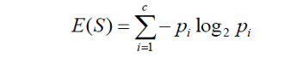
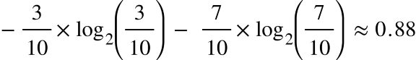
Information Gain= Entropy(S)- [(Weighted Avg) *Entropy(each feature)
Entropy: Entropy signifies the randomness in the dataset.
It is being defined as a metric to measure impurity. Entropy can be calculated as:
‘Pi’ is simply the frequentist probability of an element/class ‘i’ in our data.
let’s say we only have two classes , a positive class and a negative class.
Therefore ‘i’ here could be either + or (-).
So if we had a total of 100 data points in our dataset with 30 belonging to the positive class and 70 belonging to the negative class then ‘P+’ would be 3/10 and ‘P-’ would be 7/10

Slide 19
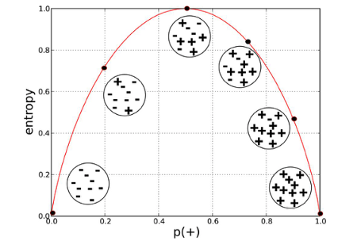
a high entropy , a high level of disorder ( meaning low level of purity).
Entropy is measured between 0 and 1.
Depending on the number of classes in your dataset, entropy can be greater than 1 but it means the same thing , a very high level of disorder.
Entropy is lowest at the extremes, when the bubble either contains no positive instances or only positive instances.
That is, when the bubble is pure the disorder is 0.
Entropy is highest in the middle when the bubble is evenly split between positive and negative instances.
Extreme disorder , because there is no majority.
Entropy is a measure of disorder or uncertainty and the goal of machine learning models and Data Scientists in general is to reduce uncertainty.

Slide 20
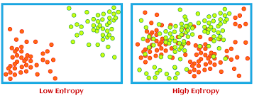

Slide 21
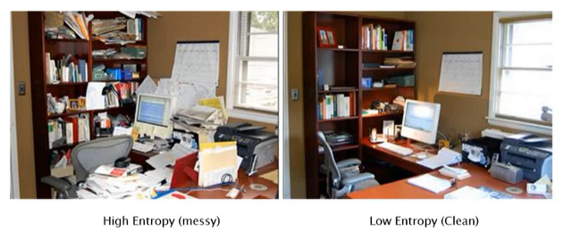
We simply subtract the entropy of Y given X from the entropy of just Y to calculate the reduction of uncertainty about Y given an additional piece of information X about Y.
This is called Information Gain.
The greater the reduction in this uncertainty, the more information is gained about Y from X.

Slide 22
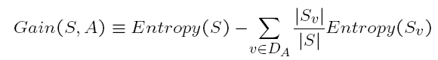
Information Gain (S=E)
Gain(S,A): expected reduction in entropy due to sorting S on attribute A
Entropy([29+,35-]) = -29/64 log2 29/64 – 35/64 log2 35/64
= 0.99
[29+,35-]
A₁=?
A₂=?
[29+,35-]
G
H
True
False
[21+, 5-]
[8+, 30-]
[18+, 33-]
[11+, 2-]

Slide 23
Information Gain
Entropy([18+,33-]) = 0.94
Entropy([11+,2-]) = 0.62
Gain(S,A2)=Entropy(S)
-51/64*Entropy([18+,33-])
-13/64*Entropy([11+,2-])
=0.12
Entropy([21+,5-]) = 0.71
Entropy([8+,30-]) = 0.74
Gain(S,A₁)=Entropy(S)
-26/64*Entropy([21+,5-])
-38/64*Entropy([8+,30-])
=0.27
[29+,35-]
A₁=?
A₂=?
[29+,35-]
True
False
True
False
[21+, 5-]
[8+, 30-]
[18+, 33-]
[11+, 2-]

Slide 24
Day | Outlook | Temp. | Humidity | Wind | Play Tennis
D1 | Sunny | Hot | High | Weak | No
D2 | Sunny | Hot | High | Strong | No
D3 | Overcast | Hot | High | Weak | Yes
D4 | Rain | Mild | High | Weak | Yes
D5 | Rain | Cool | Normal | Weak | Yes
D6 | Rain | Cool | Normal | Strong | No
D7 | Overcast | Cool | Normal | Weak | Yes
D8 | Sunny | Mild | High | Weak | No
D9 | Sunny | Cold | Normal | Weak | Yes
D10 | Rain | Mild | Normal | Strong | Yes
D11 | Sunny | Mild | Normal | Strong | Yes
D12 | Overcast | Mild | High | Strong | Yes
D13 | Overcast | Hot | Normal | Weak | Yes
D14 | Rain | Mild | High | Strong | No

Slide 25
Step 1: Determine the Decision Column
compute the entropy
To do this, we create a frequency table for the classes (the Yes/No column).
Step 2: Calculating Entropy for the classes (Play Tennis)
Entropy(PlayTennis) = E(5,9)
E(S) = -[(9/14)log(9/14) + (5/14)log(5/14)] = 0.94
– [9+,5-]

Slide 26
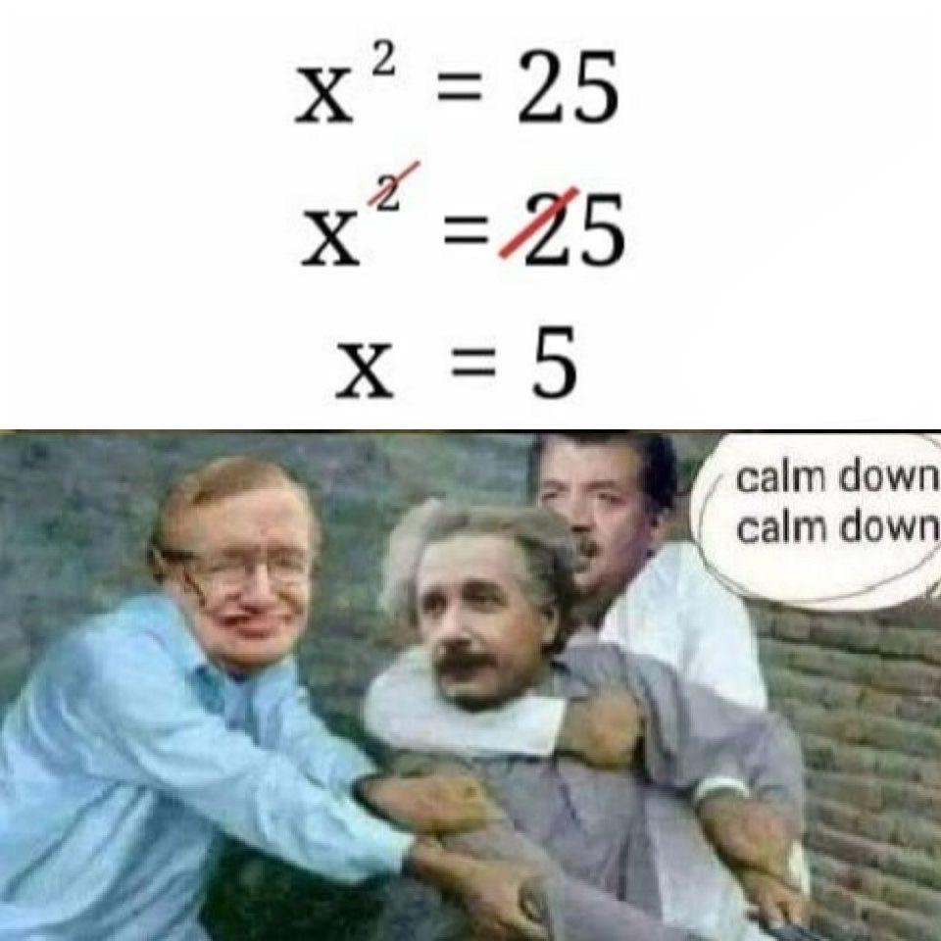
Step 3: Calculate Entropy for Other Attributes After Split
for the other four attributes, we need to calculate the entropy after each of the split.
E(PlayTennis, Outloook)
E(PlayTennis, Temperature)
E(PlayTennis, Humidity)
E(PlayTennis,Wind)
The entropy for two variables is
calculated using the formula.

Slide 27
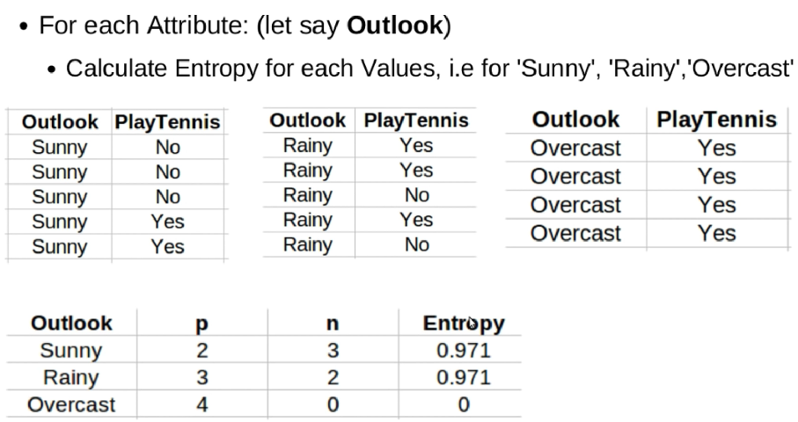
Calculate the Entropy for the entire data set
Entropy([9+,5-] = – (9/14) log₂(9/14) – (5/14) log₂(5/14) = 0.940

Slide 28
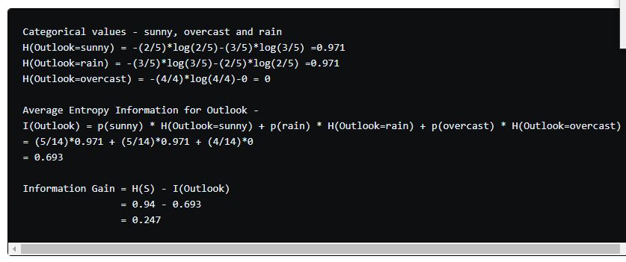
First Attribute - Outlook

Slide 29
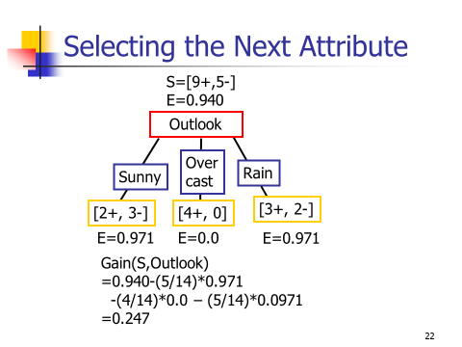

Slide 30
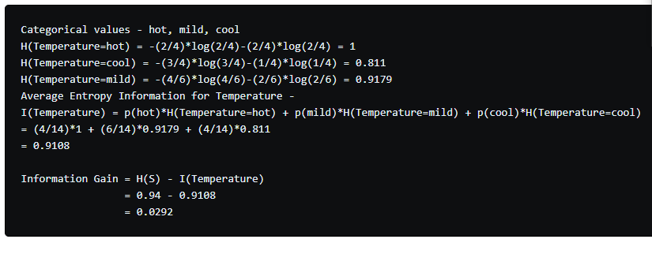
Second Attribute - Temperature

Slide 31
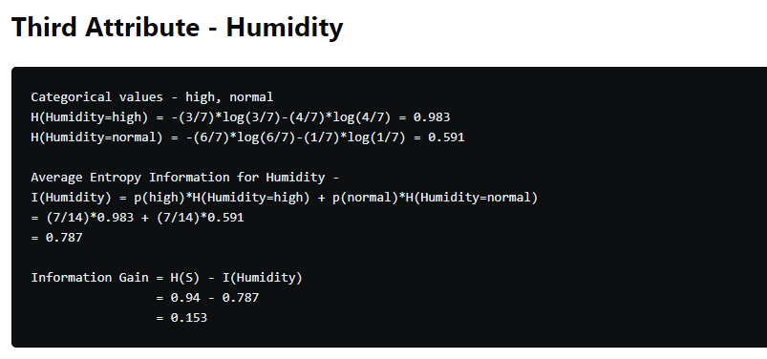

Slide 32
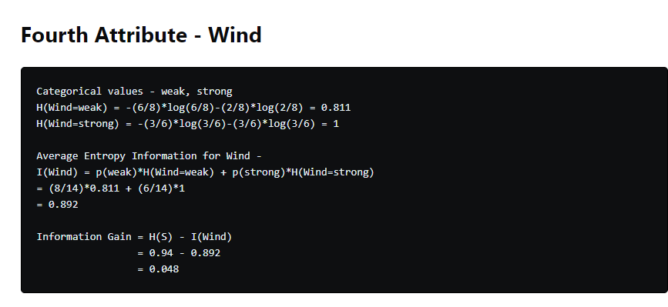

Slide 33
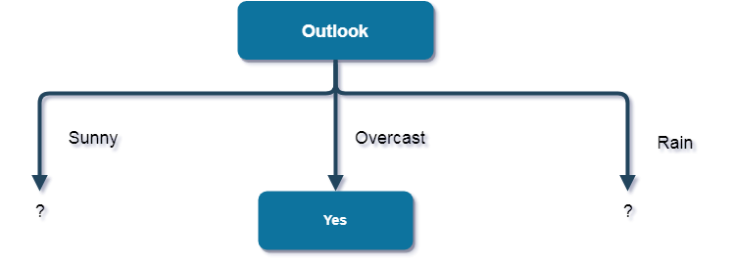

Slide 34
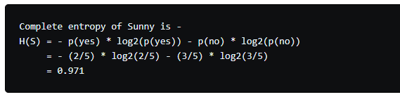
Now, finding the best attribute for splitting the data with Outlook=Sunny values{ Dataset rows = [1, 2, 8, 9, 11]}.

Slide 35
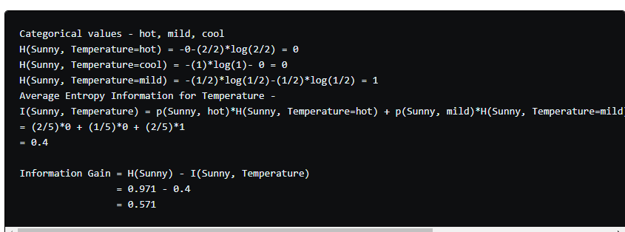
1st Attribute : Temp

Slide 36
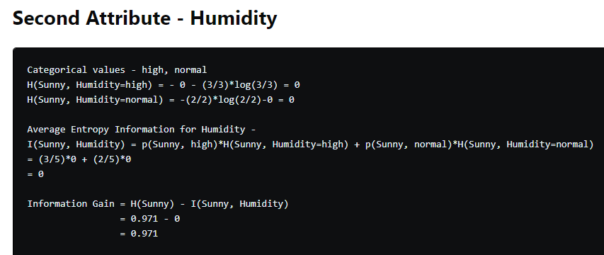

Slide 37
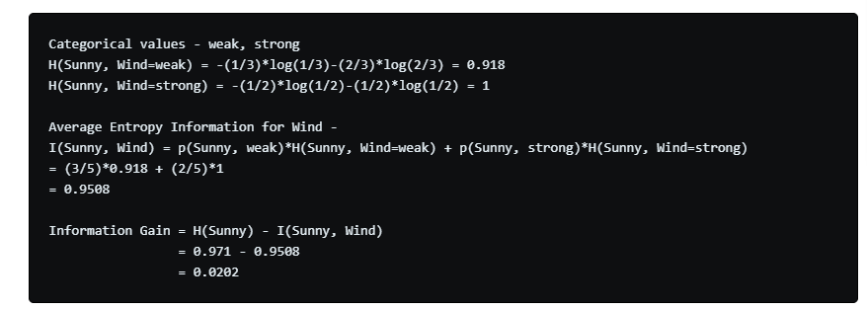
3rd Attribute:Wind

Slide 38
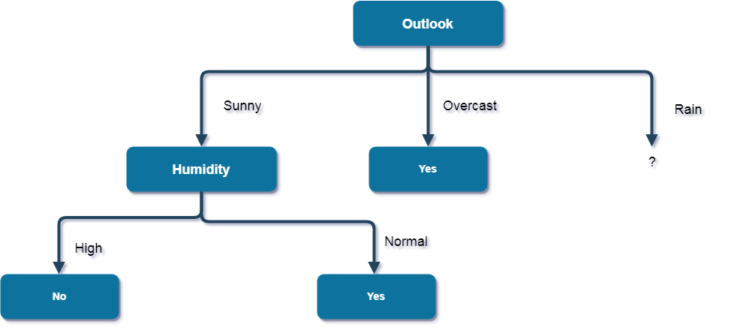

Slide 39
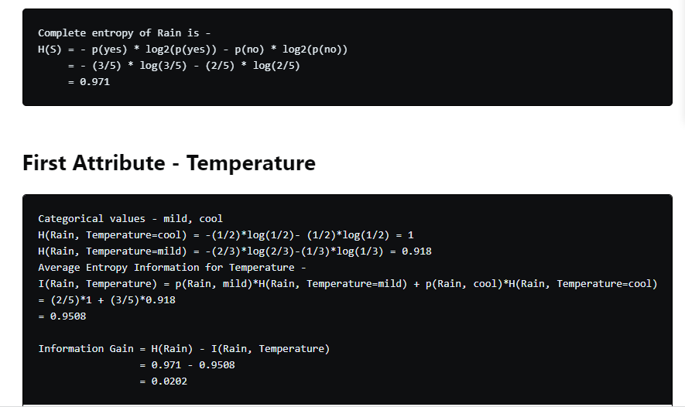
Now, finding the best attribute for splitting the data with Outlook=Rainy values{ Dataset rows = [4, 5, 6, 10, 14]}.

Slide 40
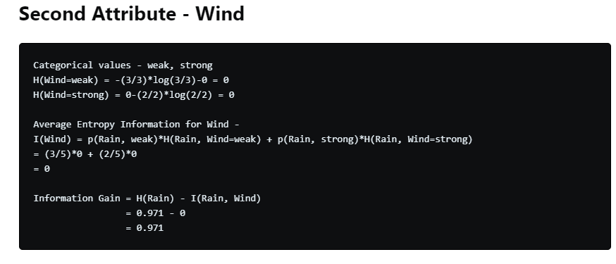

Slide 41
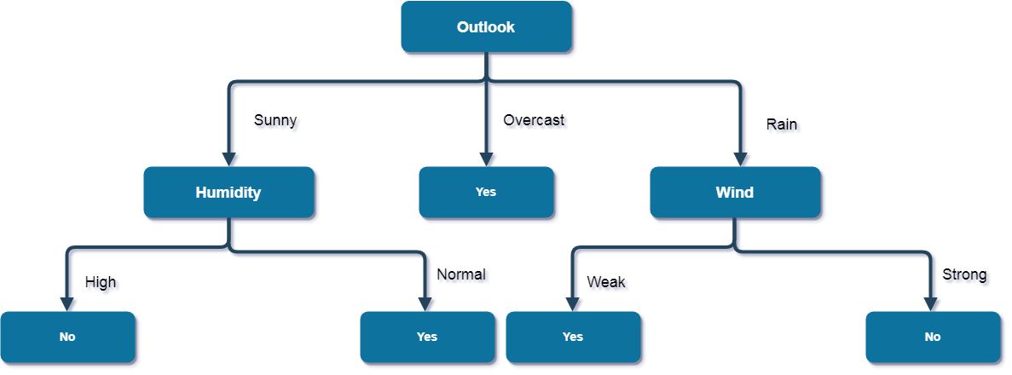

Slide 42


Slide 43
ID3(Examples, TargetAttribute, Attributes)
Create a Root node for the tree
If all Examples are positive, Return the single-node tree Root, with label = +
If all Examples are negative, Return the single-node tree Root, with label = -
If Attributes is empty, Return the single-node tree Root, with label = most common value of TargetAttribute in Examples
Otherwise Begin
A ← the attribute from Attributes that best classifies Examples
The decision attribute for Root ←A
For each possible value, vi, of A,
Add a new tree branch below Root, corresponding to the test A = vi
Let Examples_{vi} be the subset of Examples that have value vi for A
If Examples_{vi} is empty
Then below this new branch add a leaf node with label = most common
value of TargetAttribute in Examples
Else below this new branch add the subtree
ID3(Examples_{vi} , TargetAttribute, Attributes – {A})
End
Return Root

Slide 44
Hypothesis space
The hypothesis space searched by ID3 is the set of possible decision trees.
ID3 performs a simple-to complex, hill-climbing search through this hypothesis space,
Begins with the empty tree, then considers progressively more elaborate hypotheses in search of a decision tree that correctly classifies the training data.
The information gain measure guides the hill-climbing search.
If Features are continuous, then threshold value is used for testing the internal nodes
It can occur more than once but discrete features should appear only once

Slide 45
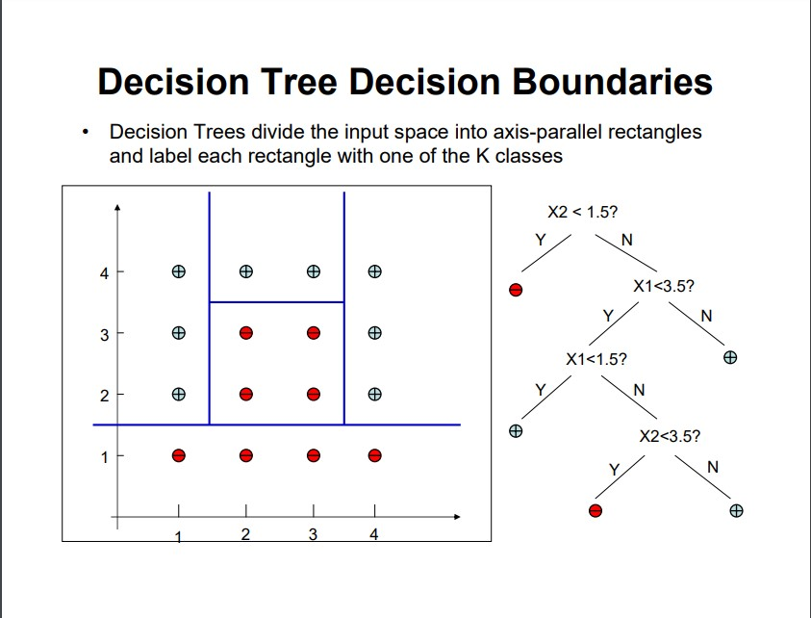
Decision boundaries

Slide 46
When the number of nodes increases, the hypothesis space grows
Depth1 (decision stump) – Boolean function for any feature
Depth2 (any Boolean function that involves 2 features/ some function that includes 3 features)
X1 and x2 or not(x1) and not(x2)

Slide 47
Inductive Bias in ID3
ID3 search strategy
selects in favor of shorter trees over longer ones,
selects trees that place the attributes with highest information gain closest to the root.
because ID3 uses the information gain heuristic and a hill climbing strategy, it does not always find the shortest consistent tree, and it is biased to favor trees that place attributes with high information gain closest to the root.
Inductive Bias of ID3:
Shorter trees are preferred over longer trees.
Trees that place high information gain attributes close to the root are preferred over those that do not.
Introduction to Machine Learning
47

Slide 48
Inductive Bias in ID3 - Occam’s Razor
OCCAM'S RAZOR: Prefer the simplest hypothesis that fits the data.
Why prefer short hypotheses?
Argument in favor:
Fewer short hypotheses than long hypotheses
A short hypothesis that fits the data is unlikely to be a coincidence
A long hypothesis that fits the data might be a coincidence
Argument opposed:
There are many ways to define small sets of hypotheses
What is so special about small sets based on size of hypothesis
Introduction to Machine Learning
48

Slide 49
Inductive Bias in ID3 – Restriction Bias and Preference Bias
ID3 searches a complete hypothesis space
It searches incompletely through this space, from simple to complex hypotheses, until its termination condition is met
Its inductive bias is solely a consequence of the ordering of hypotheses by its search strategy.
Its hypothesis space introduces no additional bias.
Candidate Elimanation searches an incomplete hypothesis space
It searches this space completely, finding every hypothesis consistent with the training data.
Its inductive bias is solely a consequence of the expressive power of its hypothesis representation.
Its search strategy introduces no additional bias.
Introduction to Machine Learning
49

Slide 50
Inductive Bias in ID3 – Restriction Bias and Preference Bias
The inductive bias of ID3 is a preference for certain hypotheses over others, with no hard restriction on the hypotheses that can be eventually enumerated.
➔ preference bias ( search bias ).
The inductive bias of Candidate Elimination is in the form of a categorical restriction on the set of hypotheses considered.
➔ restriction bias ( language bias )
A preference bias is more desirable than a restriction bias, because it allows the learner to work within a complete hypothesis space that is assured to contain the unknown target function.
Introduction to Machine Learning
50

Slide 51
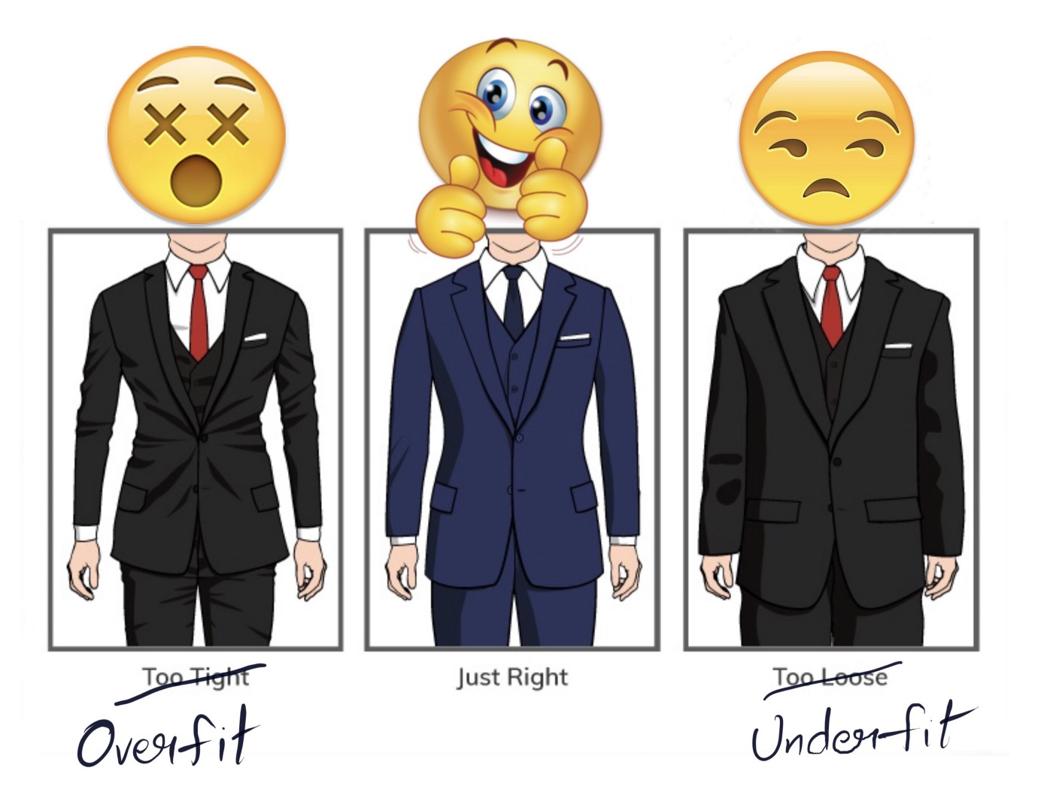

Slide 52
Overfitting
If a decision tree is fully grown, it may lose some generalization capability. This is a phenomenon known as overfitting.
Given a hypothesis space H, a hypothesis h∈H is said to OVERFIT the training data if there exists some alternative hypothesis h'∈H, such that h has smaller error than h' over the training examples, but h' has a smaller error than h over the entire distribution of instances.
Reasons for overfitting:
Errors and noise in training examples
coincidental regularities (especially small number of examples are associated with leaf nodes).
Introduction to Machine Learning
52

Slide 53
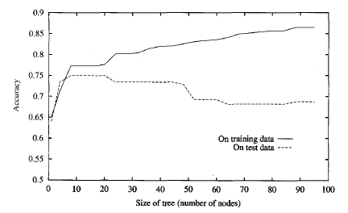
Overfitting
As ID3 adds new nodes to grow the decision tree, the accuracy of the tree measured
over the training examples increases monotonically.
However, when measured over a set of test examples independent of the training
examples, accuracy first increases, then decreases.
Introduction to Machine Learning
53

Slide 54
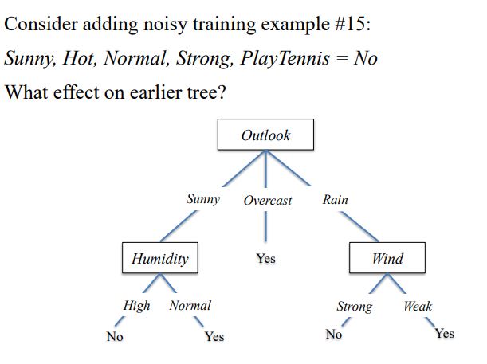
NOISE/ERROR DATA

Slide 55
Avoid overfitting
Pre-pruning
stop growing the tree earlier, before it reaches the point where it perfectly classifies the training data
Post pruning
allow the tree to over fit (recover) the data, and then post-prune the tree.
Reduced Error pruning
Rule post pruning
How to select the best tree?
Measure performance over
the training data
validation data
MDL Minimize
size(tree) + size(misclassifications(tree))

Slide 56
Avoid Overfitting - Reduced-Error Pruning
Split data into training and validation set
Do until further pruning is harmful:
Evaluate impact on validation set of pruning each possible node (plus those below it)
Greedily remove the one that most improves the validation set accuracy
Pruning of nodes continues until further pruning is harmful (i.e., decreases accuracy of the tree over the validation set).
Using a separate set of data to guide pruning is an effective approach provided a large amount of data is available.
The major drawback of this approach is that when data is limited, withholding part of it for the validation set reduces even further the number of examples available for training.
Introduction to Machine Learning
56

Slide 58
Effect of Reduced Error Pruning
the accuracy increases over the test set as nodes are pruned from the tree.
the validation set used for pruning is distinct from both the training and test sets.

Slide 59
Rule-Post Pruning
Rule-Post Prunning is another sucessful method for finding high accuracy hypotheses.
It is used by C4.5 learning algorithm (an extension of ID3).
Steps of Rule-Post Pruning:
Infer the decision tree from the training set.
Convert the learned tree into an equivalent set of rules by creating one rule for each path from the root node to a leaf node.
Prune (generalize) each rule by removing any preconditions that result in improving its estimated accuracy.
Sort the pruned rules by their estimated accuracy, and consider them in this sequence when classifying subsequent instances.

Slide 60
Converting a Decision Tree to Rules
Outlook
Sunny
Overcast
Rain
Humidity
Yes
Wind
High
Normal
Strong
Weak
No
Yes
No
Yes
R1: If (Outlook=Sunny) ∧ (Humidity=High) Then PlayTennis=No
R2: If (Outlook=Sunny) ∧ (Humidity=Normal) Then PlayTennis=Yes
R3: If (Outlook=Overcast) Then PlayTennis=Yes
R4: If (Outlook=Rain) ∧ (Wind=Strong) Then PlayTennis=No
R5: If (Outlook=Rain) ∧ (Wind=Weak) Then PlayTennis=Yes

Slide 61
Rule-Post Pruning
Comparing first rule If (Outlook=Sunny) ∧ (Humidity=High) Then PlayTennis=No to
Subrule1 :Outlook = sunny-> no
Subrule2 : Humidity=high->no
Use the validation data and check on rule1,subrule1 and subrule2.
Compute accuracy for all 3 and find the best version

Slide 62
Why Convert The Decision Tree To Rules Before Pruning?
Converting to rules improves readability.
Rules are often easier for to understand.
Distinguishing different contexts in which a node is used
separate pruning decision for each path
No difference for root/inner
no bookkeeping on how to reorganize tree if root node is pruned

Slide 63
Continuous-Valued Attributes
ID3 is restricted to attributes that take on a discrete set of values.
Define new discrete valued attributes that partition the continuous attribute value into a discrete set of intervals
For a continuous-valued attribute A that is, create a new boolean attribute Ac, that is true if A < c and false otherwise.
Select c using information gain
Sort examples according to the continuous attributeA,
Then identify adjacent examples that differ in their target classification
Generate candidate thresholds midway between corresponding values of A.
The value of c that maximizes information gain must always lie at a boundary.
These candidate thresholds can then be evaluated by computing the information gain associated with each.

Slide 64

Continuous-Valued Attributes - Example
Temperature: 40 48 60 72 80 90
PlayTennis : No No Yes Yes Yes No
Two candidate thresholds: (48+60)/2=54 (80+90)/2=85
Check the information gain for new boolean attributes:
Temperature_{>54} Temperature_{>85}
Use these new new boolean attributes same as other discrete valued attributes.

Slide 65
Alternative Selection Measures
Information gain measure favors attributes with many values
separates data into small subsets
high gain, poor prediction
Ex. Date attribute has many values, and may separate training examples into very small subsets (even singleton sets – perfect partitions)
Information gain will be very high for Date attribute.
Perfect partition ➔maximum gain : Gain(S,Date) = Entropy(S) – 0 = Entropy(S) because log₂1 is 0.
It has high information gain, but very poor predictor for unseen data.
There are alternative selection measures such as GainRatio measure based on SplitInformation

Slide 66
Split Information
The gain ratio measure penalizes attributes with many values (such as Date) by incorporating a term, called split informution
Split information for boolean attributes is 1 (= log₂2),
Split information fot attributes for n values is log₂n
SplitInformation term discourages the selection of attributes with many uniformly distributed values.
c
∑
SplitInformation(S,A) = - ( |Si| / |S| ) log₂ ( |Si| / |S| )
i=1
GainRatio(S,A) = Gain(S,A) / SplitInformation(S,A)

Slide 67
Practical Issues on Split Information
Some value ‘rules’
|Si| close to |S|
SplitInformation 0 or very small
GainRatio undefined or very large
Apply heuristics to select attributes
compute Gain first
compute GainRatio only when Gain large enough (above average Gain)

Slide 68
Missing Attribute Values
The available data may be missing values for some attributes.
It is common to estimate the missing attribute value based on other examples for which this attribute has a known value.
Assume that an example (with classification c) in S has a missing value for attribute A.
Assign the most common value of A in S.
Assign the most common value of in the examples having c classification in S.
Or, use probabilty value for each possibşe attribute value.

Slide 69
Attributes with Differing Costs
Measuring attribute costs something
prefer cheap ones if possible
use costly ones only if good gain
introduce cost term in selection measure
no guarantee in finding optimum, but give bias towards cheapest
Example applications
robot & sonar: time required to position
medical diagnosis: cost of a laboratory test

Slide 70
Weather data (again!)
Outlook
Outlook
Outlook
Temperature
Temperature
Temperature
Humidity
Humidity
Humidity
Windy
Windy
Windy
Play
Play
Play
Sunny
Sunny
Sunny
Hot
Hot
Hot
High
High
High
False
False
False
No
No
No
Sunny
Sunny
Sunny
Hot
Hot
Hot
Outlook
Outlook
Outlook
High
High
High
Temperature
Temperature
Temperature
True
True
True
Humidity
Humidity
Humidity
No
No
No
Windy
Windy
Windy
Play
Play
Play
Overcast
Overcast
Overcast
Hot
Hot
Hot
Sunny
Sunny
Sunny
High
High
High
Hot
Hot
85
False
False
False
High
High
85
Yes
Yes
Yes
False
False
False
No
No
No
Sunny
Sunny
Sunny
Hot
Hot
80
High
High
90
True
True
True
No
No
Rainy
No
Rainy
Rainy
Mild
Mild
Mild
Normal
Normal
High
False
False
False
Yes
Yes
Yes
…
…
…
…
…
…
Overcast
Overcast
Overcast
…
…
…
Hot
Hot
83
…
…
…
High
High
86
…
…
…
False
False
False
Yes
Yes
…
Yes
…
Rainy
…
…
Cool
…
…
Normal
…
…
False
…
…
Yes
…
…
Rainy
…
…
Cool
Rainy
Rainy
Rainy
…
…
Normal
Mild
Mild
70
…
…
True
Normal
Normal
96
…
…
No
False
False
False
Yes
Yes
Yes
…
…
…
…
…
…
…
…
…
…
…
…
…
…
…
…
…
…
…
…
…
…
…
Rainy
…
…
…
…
…
68
…
…
…
…
…
80
…
…
…
…
…
False
…
…
Yes
…
…
Rainy
…
…
65
…
…
70
…
…
True
…
…
No
…
…
…
…
…
…
…
…
…
…
…
…
…
…
…
If outlook = sunny and humidity = high then play = no
If outlook = rainy and windy = true then play = no
If outlook = overcast then play = yes
If humidity = normal then play = yes
If none of the above then play = yes
If outlook = sunny and humidity > 83 then play = no
If outlook = rainy and windy = true then play = no
If outlook = overcast then play = yes
If humidity < 85 then play = no
If none of the above then play = yes
Notes:
03-Sep-22
70
70

